Slide 1
Yummy Cooking
SummerI2019 CS639 Final Project
Team#3
Guanggeng Yang
Danni Huang

Slide 2
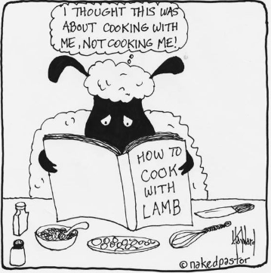
1.Solve the problem
With the first few months of living away from home, most of us find that splitting our meals between the campus dining hall and local fast food joints is not going to cut it for the next two (or more) years. Especially for the international students who did not cook at home before, cooking is a big challenge for many of my friends and me to handle a whole day meal when we live alone.
In order to solve this problem, we decide to create an app named “Yummy Cooking.”
Yummy Cooking can guide cook-beginner to prepare a yummy meal.
There are various problems which are faced by cook beginners like What meal should I cook ? How to cook it ? what cookers and materials I need? where to buy the raw materials? What is the estimated cost for a meal?
So The “Yummy Cooking” will guide the cook-beginner step by step to prepare a good meal.

Slide 3


2.Target users
I am International student Young.
I don’t have cook experience. But I want to make homemade meal to lower my living budget during studying in New York. So I would love to use the “Yummy Cooking ”to plan my meal.
We are students who live in New York. We are all cook-beginners.

Slide 4
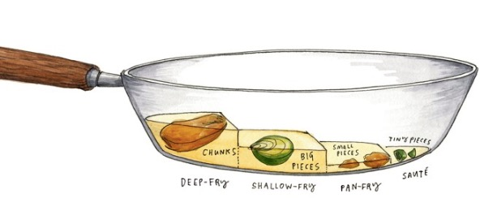
3.The features of the solution
Recommendation of Recipes.
It provides the food picture, cooking time, estimated cost and serving for the specific meal.
It also provides a purchase location of need raw materials on the google map.
Click the food picture you want to make, it directs to the cooking detail page.
The page includes:
Meal Picture
Ingredients
instructions
Purchase location
Share the recipes

Slide 5
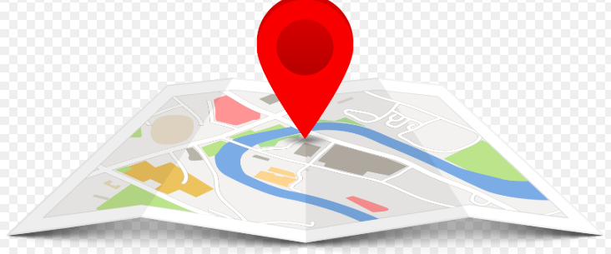
4.The unique solutions
After going through few similar cooking apps, we found that they provide online purchase of raw materials. That means you can get raw materials couple days after. But for the group of people don’t want to wait for so long, we provide the solutions is that show the any possible purchase location nearby to help them get raw materials immediately.

Slide 6
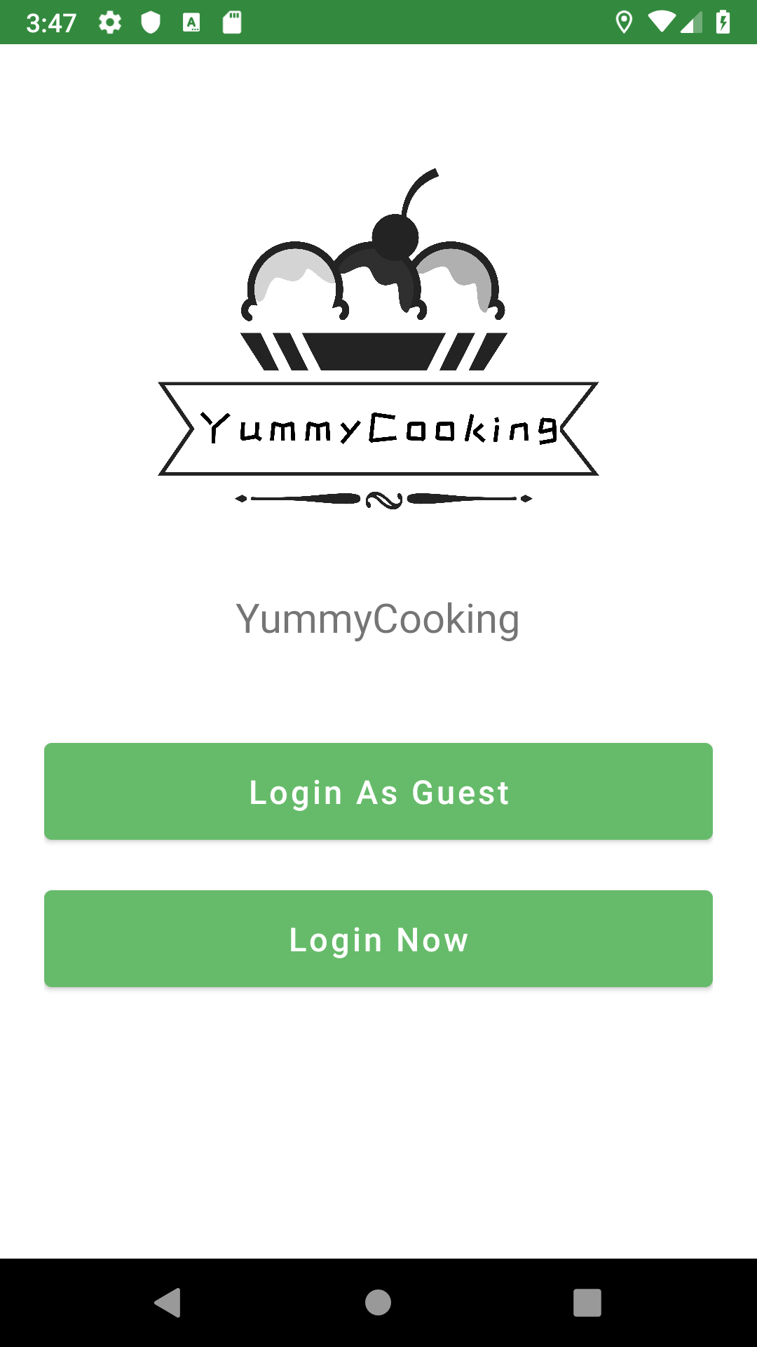
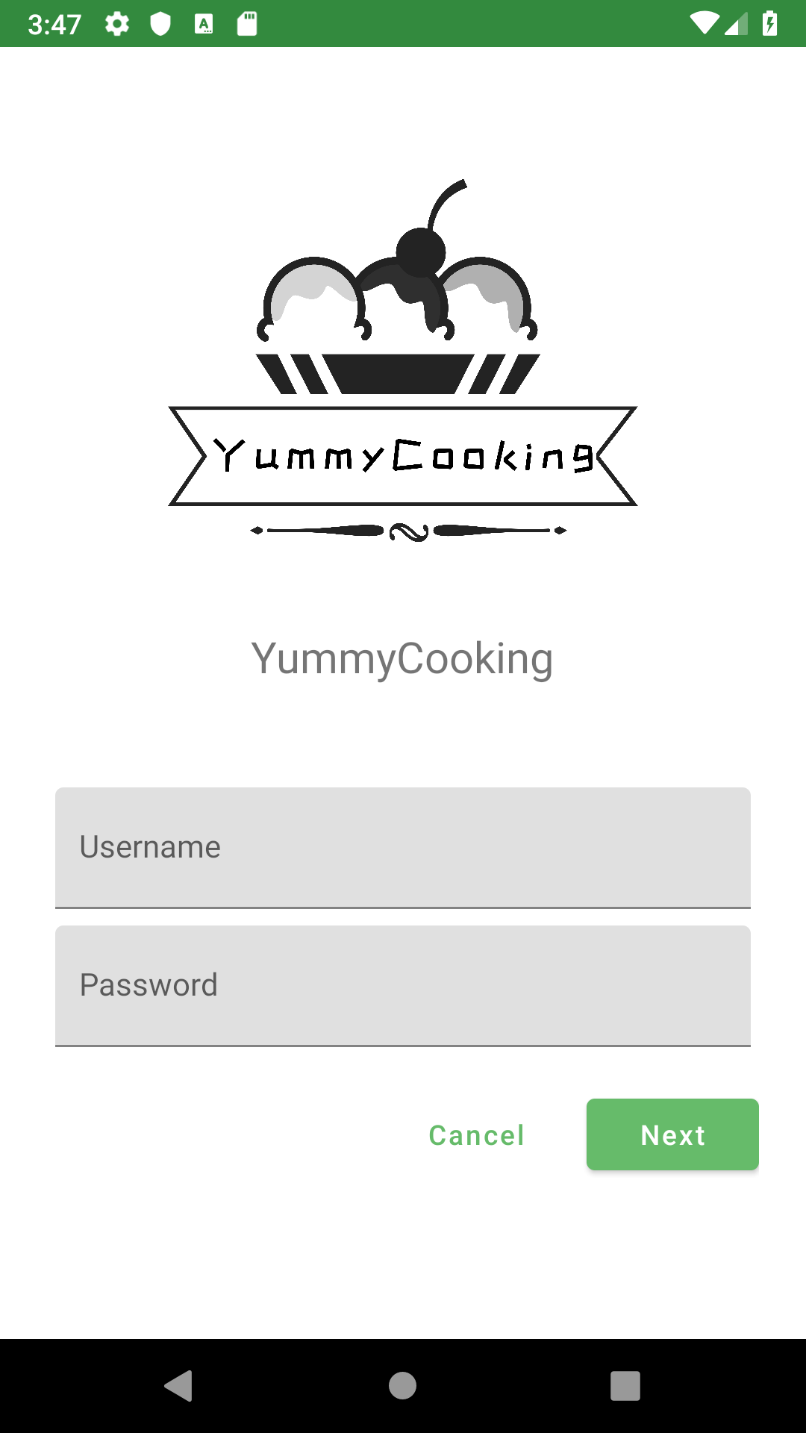
5.APP Screenshots

Slide 7
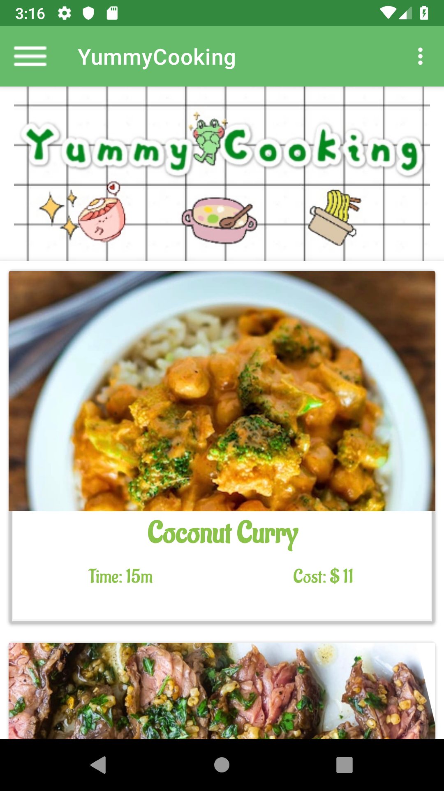
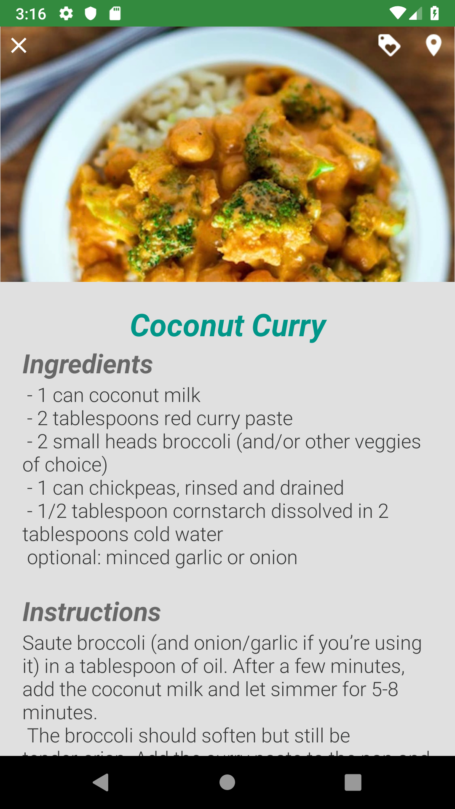
APP Screenshots

Slide 8
Link to Video

Slide 9

6.Problems encountered in the development of the app
Can not acquire the pictures from firebase cloud store;
a problem to return the last activity by clicking back icon;
Don’t know how to generate drawable xml file.

Slide 10

5.The technologies used to develop
We use android studio to develop the app.
The min SDK 24 and target SDK 28.

Slide 11
References
https://material.io/design/
https://codelabs.developers.google.com/codelabs/mdc-101-java/
https://codelabs.developers.google.com/codelabs/mdc-102-java/
https://codelabs.developers.google.com/codelabs/mdc-103-java/
https://codelabs.developers.google.com/codelabs/mdc-104-java

Slide 12


